Slide 1
NASA SPACE APPS -2023
Team: genration z
Yasvindhini U
Sangeetha J
Sathiya Priya R
Indhuja M
Karthisri T

Slide 2
SUMMARY:
Challenge is to create a look around your neighborhood or town and formulate a question about how the environment and humans are related. In our way of creating and approach the public is to create a visual treat for them by using visual presentation.For that we have thought about creating a easy and quick way of approach, so here were going to present you guys a visual treat of poster and a animated video.

Slide 3
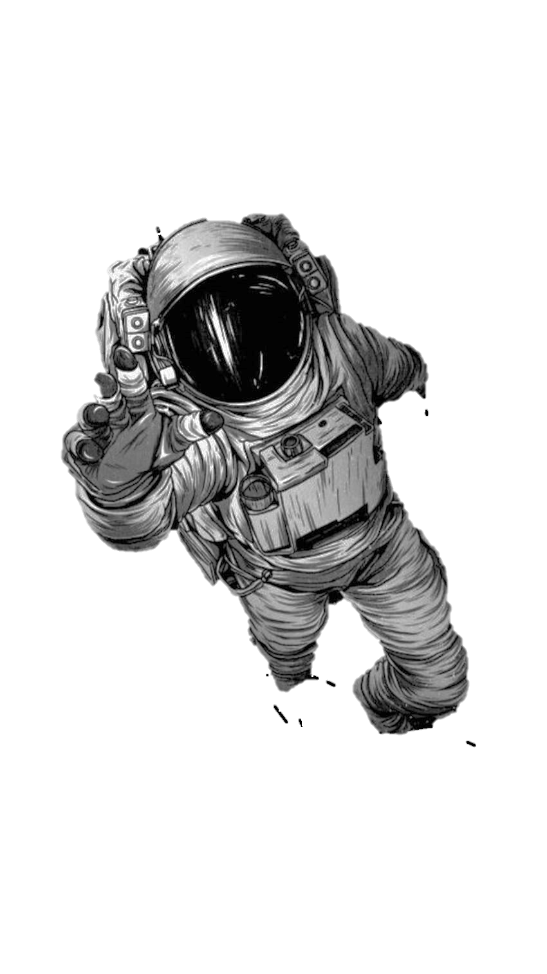
Challenge:
NASA IN YOUR NEIGHBOURHOOD

Slide 4
Description:
By doing these presentations we have been trying to tell you guys a matter is solar system is our family and the other planets in our solar system were our neighbors .We have presented a clean and detailed poster about how NASA’s contribution is an huge impact for other space agencies by doing so many researches in the space and other planets. And in the video we have explained the contribution of NASA in the cosmic world.

Slide 5
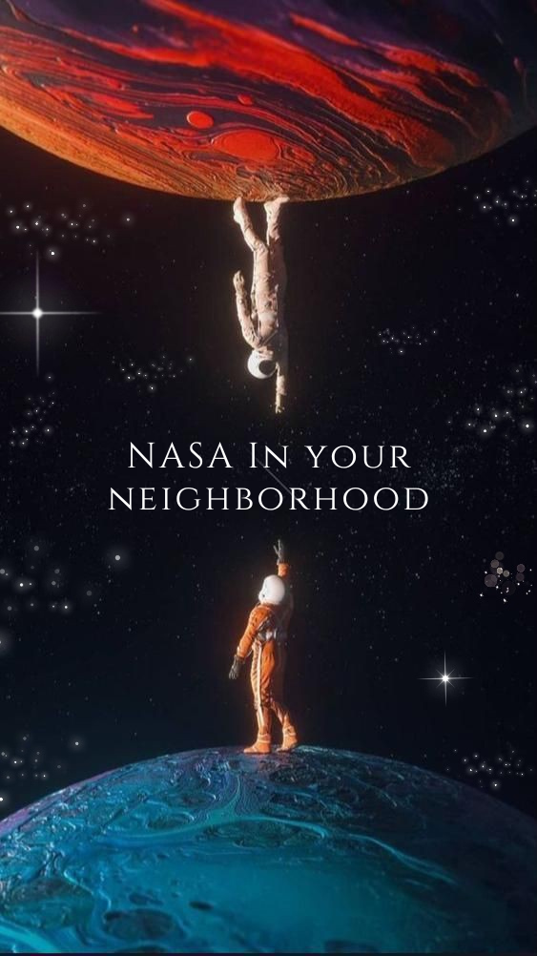
Poster:
https://www.canva.com/design/DAFwl6HROIo/Tzv6648fVF7Z5psL7Zad1A/edit?utm_content=DAFwl6HROIo&utm_campaign=designshare&utm_medium=link2&utm_source=sharebutton

Slide 6
Video link:

Slide 7
Conclusion:
So, here we presented you guys a visual representation of how humans and environment is related to each other and we have submitted a poster and a video and how NASA is creating the influence in the space journey. And how it is improved from and past and how it will get improved by the future generation. By considering another planets in our solar system we hope that NASA will reach out to other planets in our solar system with great and impressive technology.

